Slide 1

Student Information System
Steven Bodnar
Majid Joseph
Kolby Sarson

Slide 2
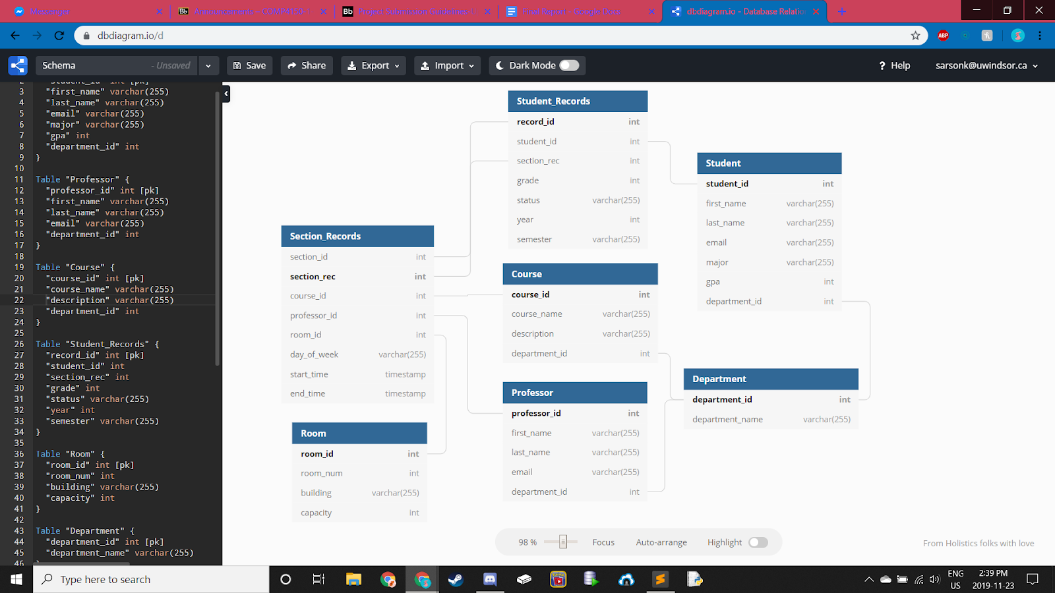
ER Diagram

Slide 3
Software Used
Database
MySQL
MySQL Workbench
MySQL Server
GUI
NodeJS
ExpressJS
Angular

Slide 4
Features
Backend initialization script to fully create and initialize the database
Creates and selects schema, creates tables with pk/fk, creates application user, and inserting randomly generated records
Homepage with quick access queries
Sorted by purpose (reports, student management, course management)
Database table display
Selectable rows for detailed, user-friendly record displays
Queries requiring user input utilize forms for simple inputting

Slide 5
Basic Queries
Select all of the courses that a certain student is taking
Select all of the courses that a certain professor is teaching
Select all of the courses where a student gets an A
Select all students taking a specific course
Select the room that a course is being taught in
Select all students currently taking a course with a certain professor

Slide 6
Advanced Queries
Update grades to add a 5% curve to the grades of all students in a certain section of a course
Delete a student from a course who voluntarily dropped it online
Update a student’s major
Update a student’s section of a course
Update the professor who is teaching a course section
Calculate the average of a course section

Slide 7
Example
calculateGPA()
Iterates through each student calculating their GPA
Calls getGrades() on each student to return the sum and # of grades
Uses the sum and the count to calculate the GPA
getGrades()
Counts the # of grades a given student has
Sums the grades of a given student
Update Trigger
If a curve is applied to a course, then for each student calculateGPA() is called again to account for the update grade

